Slide 1



“Network Vigilance: Creating an Effective NIDS”
Web Server NIDS are increasingly vulnerable to a variety of the cyber threats, including evolving attacks techniques like SQL injection and zero day vulnerability.

Slide 2






Guide :
Soma Saha Adarsh Patel
Shahana Gajala Qureshi
Team Members:
Ankit Kumar (22BCY10224) Deo Sagar Kumar (22BCY10027))
Ujjwal Jain (22BCY10016) Shubham Agarwal (22BCY10025) Sajal Seth (22BCY10013)

Slide 3




IDS (INTRUSION DETECTION SYSTEM)
A SYSTEM OBSERVES NETWORK TRAFFIC FROM MALICIOUS TRASACTION AND SENDS IMMEDIATE ALERTS .
IT PROTECTS COMPUTERS FROM UNAUTHORIZED ACCESS.
THE INRTUSIO DETECTOR LEARS FROM PREDICTCTIVE MODEL(CLASSIFIERS), DISTINGUSHING BETWEEN “BAD CONNECTIONS” AND “GOOD CONNETCTIONS”
WHAT IS NIDS???
NETWORK INTRUSION DETECTION SYSTEM

Slide 4



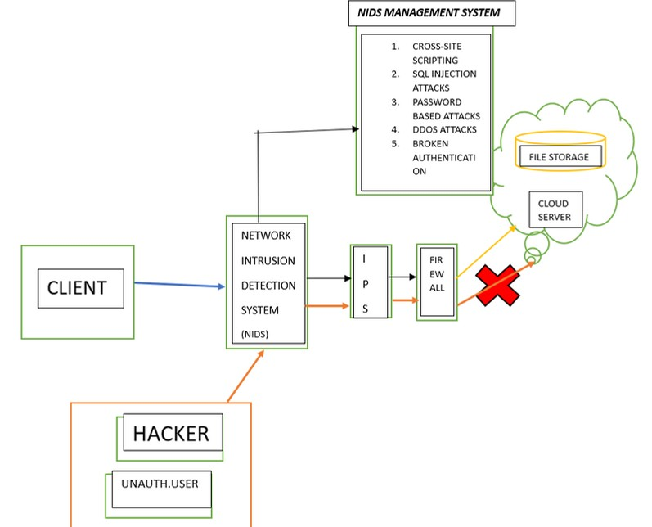


WORKING OF NIDS:

Slide 5


WORKING:
An IDS (Intrusion Detection System) monitors the traffic on a computer network to detect any suspicious activity.
It analyzes the data flowing through the network to look for patterns and signs of abnormal behavior.
The IDS compares the network activity to a set of predefined rules and patterns to identify any activity that might indicate an attack or intrusion.
It performs an analysis of passing traffic on the entire subnet, and matches the traffic that is passed on the subnets to the library of known attacks
If the IDS detects something that matches one of these rules or patterns, it sends an alert to the system administrator.
The system administrator can then investigate the alert and take action to prevent any damage or further intrusion.

Slide 6






APPLICATION AND PRINCIPLES
Security Monitoring: NIDS continuously analyze network traffic and raise alerts when they detect potentially malicious or abnormal behavior. This helps network administrators identify and respond to security incidents in real-time.
Intrusion Detection: NIDS can detect a wide range of intrusion attempts, such as port scans, denial-of-service attacks, brute-force login attempts, and more. By analyzing network packets, they can flag activities that deviate from the norm.
Incident Response: NIDS plays a vital role in incident response by providing early detection and valuable information about the nature of the threat, enabling organizations to react promptly and effectively.
Threat Intelligence: Some NIDS solutions incorporate threat intelligence feeds, which provide real-time information on known threats and vulnerabilities. This helps the system detect and respond to threats more effectively.

Slide 7






Signature-Based Detection: One of the primary methods NIDS use for detection is signature-based detection. This involves comparing network traffic patterns against a database of known attack patterns or signatures. When a match is found, the NIDS generates an alert.
Event Logging: NIDS generate logs and alerts when they detect potentially malicious or abnormal activity. These logs can be used for forensic analysis and compliance reporting. They also aid in incident response by providing detailed information about security incidents.
Scalability: NIDS must be scalable to accommodate the network's size and traffic volume. They should be able to handle a large number of packets per second without causing network congestion or performance issues.
Privacy and Data Protection: NIDS should adhere to privacy and data protection regulations. They should not capture or store sensitive information without proper consent or encryption.

Slide 8
EXISTING WORK OR WORK IN PROCESS
1: Signature-Based Detection
In the first method, Network Intrusion Detection Systems (NIDS) rely on signature- based detection techniques. They maintain a database of known attack patterns or "signatures."
These signatures are compared with the network traffic as it flows through the system. When a match is identified between the observed traffic and a known signature, the NIDS generates an alert. This method is highly effective at identifying well-documented threats, including viruses, malware, and established attack techniques. The detection process is based on predefined patterns of malicious behavior.
2: Anomaly-Based Detection
The second method used by NIDS involves anomaly-based detection. Here, NIDS
establish a baseline of normal network behavior by continuously monitoring network traffic over time. They build a profile of expected activity and behavior within the network. When network traffic deviates from this established baseline, it is flagged as potentially suspicious or
malicious. Anomaly-based NIDS are capable of detecting previously unknown or "zero-day" threats by identifying unusual patterns or activities in the network. This approach is essential for identifying emerging attack techniques that lack predefined signatures.

Slide 9
LIMITATIONS IN EXISTING WORK
1.Testing Scope: The proposed testing approach focuses on a specific type of attack scenario involving an isolated system. This scope may not cover the full
spectrum of potential threats and vulnerabilities that a network might face in a real-world scenario.
Resource Intensive: Setting up an isolated system with dedicated hardware and software for testing can be resource-intensive. Smaller organizations or those with
limited resources might not be able to replicate this environment, which could affect the comprehensiveness of their NIDS testing.
3. Real-World Variability: In practice, network attacks can be highly variable, and the
2.
effectiveness of an NIDS may differ based on the specific attack vectors and techniques used by real attackers. Testing under controlled conditions might not fully represent these real-world variations.
4. Ethical Considerations: Conducting attacks, even in a controlled environment, raises ethical and legal concerns. Unauthorized access or disruption of systems can
potentially violate laws and regulations. Testing should be conducted within the boundaries of legal and ethical guidelines.

Slide 10
5.
Limited Ruleset: The system mentions a limited set of rules for NIDS testing. Effective NIDS should ideally have a comprehensive set of rules to detect various
types of threats. Enhancing the ruleset is a valid consideration for better coverage, but it also requires ongoing maintenance to stay up to date with emerging threats.
Automation Challenges: Implementing AI for automating NIDS and alert decoding is a complex task. It requires extensive resources, including skilled personnel, data for
training AI models, and ongoing monitoring. It may not be feasible for all organizations, especially smaller ones.
False Positives/Negatives: NIDS systems often generate false positives (incorrectly identifying normal traffic as threats) and false negatives (failing to detect actual threats). The effectiveness of an NIDS should be measured not only in terms of
detections but also in minimizing these false alerts.

Slide 11





Methodology
Project initiation and planning
Threat Assesement and Requirement Analysis System Design And Architecture
Data collection and Traffic Monitoring. Advandced Detction Techniques.

Slide 12




Methodology
Integration and Real-time Monitoring.
Performance Optimization and False Positive Reduction
User Activity and Zero Day Detection. Testing, Validation and Compliance.
Deployment, Maintenance and Training.

Slide 13
NOVELTY OF PROJECT:
Machine Learning and AI: Utilize advanced machine learning and artificial intelligence techniques for more accurate and adaptive intrusion detection. Deep learning algorithms, such as convolutional neural networks and recurrent neural networks, can enhance NIDS performance.
Threat Intelligence Integration: Integrate threat intelligence feeds to stay updated on the latest attack signatures and tactics, enriching your NIDS's detection capabilities.
Behavior Analysis: Implement behavioral analysis to detect anomalies in network traffic, which can identify novel attack patterns not covered by traditional signature-based detection.
Cloud and IoT Support: Design your NIDS to work with cloud environments and IoT devices, addressing emerging threats in these areas.
Self-Learning NIDS: Develop a self-learning NIDS that can adapt and improve its detection accuracy over time by analyzing network traffic patterns.
Attack Attribution: Explore ways to trace detected attacks back to their source, aiding in the identification of NIDS.

Slide 14





REAL TIME USAGE:
1. Immediate Threat Detection
It can monitor real-time incoming Traffic. It can detect SQL Injection, Cross- site Scripting(XSS) attacks,etc
2.
DDoS Mitigation
The Ids can detect and mitigate the real time attacks by idetifiying the traffic from multiple sources.
3. Bot and Scraping protection.
The IDS can detect unusual patterns of requests and behavior that indicate bot activity in real-time and block them from accessing the server

Slide 15




4 . Api and Web Application Security
For web applications and APIs, the IDS monitors requests and responses in real-time to identify security vulnerabilities, unauthorized access, or abnormal behavior that could indicate an attack
Real Time Log Analysis.
The IDS analyzes web server logs in real-time, looking for suspicious log entries or patterns that could indicate an ongoing intrusion attempt or an exploitation of server vulnerabilities.
Alerting and Incident Response
When the IDS detects a threat, it sends real-time alerts to security personnel or administrators, enabling immediate incident response. This can include blocking IP addresses, isolating compromised systems, or shutting down potentially affected services

Slide 16


Software Requirements for Ids
OPERATING SYSTEM :- Common choices include Linux distributions (e.g., Ubuntu, CentOS, Debian) or specialized IDS-focused operating systems like Security Onion
IDS SOFTWARE :- Common open-source IDS options include:
Snort: A widely used network-based IDS/IPS.
Suricata: Another powerful network-based IDS/IPS.
OSSEC: A host-based IDS with host intrusion detection and log analysis capabilities.
Bro/Zeek: A network analysis framework that can be used for intrusion detection.
D ATABASE MANAGEMENT SYSTEM (DBMS):
IDS software often stores and manages data about network traffic or system events. A DBMS like MySQL, PostgreSQL, or SQLite may be required for this purpose.

Slide 17




HARDWARE REQUIREMENTS
Server hardware : deploy dedicated physical servers or VMs with adequate responses
.
CPU and RAM : Choose CPU and RAM based on network traffic volume and NIDS software requirements .
S torage : Provide sufficient storage for logs , alerts , and packet capture data .
R edundancy : implement redundency and failover mechanisms for high availability.
Scalabality : plan for future growth by ensuring scalability in both hardware and architecture .
N etwork Taps / SPAN ports : Set up network taps or SPAN ports to forward traffic
to NIDS .
UPS : Connect servers to UPS units to prevent data loss during power outrages .
C ooling and Rack spaces : Ensure proper cooling and allocate rack space for
hardware .

Slide 18



System Architecture:
Network Traffic Capture:
Captures network packets or data from the network.
Packet Processing and Decoding:
Processes and decodes captured traffic, identifying protocols and services.
Traffic Analysis and Rule Evaluation:
Analyzes traffic for patterns and evaluates NIDS rules (signature-based, anomaly-based) to detect threats.
Alert Generation:
Generates alerts when suspicious or malicious activity is detected.
Alert Management and Prioritization:
Manages and prioritizes alerts based on severity.
Logging and Reporting:
Logs events and generates reports for analysis and compliance.
Alert Notification:
Notifies security personnel in real-time when critical alerts occur.
Threat Intelligence Integration:
ntegrates external threat intelligence feeds for enhanced threat detection.
Scalability, Redundancy, and User Interface:
Ensures scalability and redundancy, while administrators access and configure the NIDS through

Slide 19


MODULES AND EXPLAINATIONS
P acket Capture and Preprocessing Module:
This module encompasses packet capture, decoding, normalization, and preprocessing of network traffic. It prepares data for further analysis.
D etection Engine Module:
This module combines signature-based and anomaly-based detection. It analyzes network traffic patterns to identify known threats and deviations from normal
behavior.
A lerting and Notification Module:
Alerts generated by the NIDS are consolidated into this module. It categorizes alerts by severity and handles notifications to security personnel and external
systems.
L ogging and Reporting Module:
This module manages the recording of incidents, alerts, and network activity. It supports log storage, compliance, and reporting functions.
R esponse and Mitigation Module:
Responsible for initiating automated or manual responses to detected threats. It can include actions like blocking malicious traffic and isolating compromised hosts

Slide 20



P acket Capture and Preprocessing Module:
This module encompasses packet capture, decoding, normalization, and preprocessing of network traffic. It prepares data for further analysis.
D etection Engine Module:
This module combines signature-based and anomaly-based detection. It analyzes network traffic patterns
to identify known threats and deviations from normal behavior.
A lerting and Notification Module:
Alerts generated by the NIDS are consolidated into this module. It categorizes alerts by severity and handles notifications to security personnel and external systems.
L ogging and Reporting Module:
This module manages the recording of incidents, alerts, and network activity. It supports log storage, compliance, and reporting functions.
R esponse and Mitigation Module:
Responsible for initiating automated or manual responses to detected threats. It can include actions like blocking malicious traffic and isolating compromised hosts

Slide 21






TOOLS USED
Nmap (Network Mapper) is a powerful open-source network scanning tool used for network discovery and security auditing. It's commonly used by network administrators and security professionals to identify hosts, open ports, and services running on a network.
PySpark is the Python API for Apache Spark, a powerful open-source data processing framework. It's designed for big data processing and analytics. PySpark is a Spark library written in Python to run Python applications using Apache Spark capabilities, using PySpark we can run applications parallelly on the distributed cluster (multiple nodes).

Slide 22





ALGORITHM USED:
01.Gaussian Naive Bayes
probabilistic machine learning algorithm classify network traffic as normal or malicious calculates the
probability(assigns the label with the highest probability)
02.Decision Tree
create a tree-like structure select important features for intrusion detection, aiding analysts in identifying intrusion patterns
03.Random Forest
combines multiple decision trees
can handle mixed data types
aiding analysts in identifying intrusion patterns
anomaly detection by identifying deviations
04.Support Vector Machine
used for binary classification in NIDS,
use kernel functions to handle nonlinear relationships
high-dimensional feature space.
used in real-time NIDS
05.Logistic Regression
models the probability of an event occurring
provides coefficients assumes a linear decision boundary
L1 or L2 regularization can be applied to prevent overfitting

Slide 23
HOW TO ANALYSE:
BASED ON SUCH CIRTERIA:
NUM. OF TIMES CLIENT
LOGIN.
NUM OF FAIED LOGIN
ATTEMPTS.
NUM.OF DEVICES BEING LOGGED IN FROM THE
SAME CLIENT ID.
NUM. OF ROOT ACCESS.
NUM. OF COMPROMISED CONDITION.
NUM. OF FILE CREATION .
NUMBER OF SHELL PROMPTED.
GUEST LOGINS.

Slide 24
PSEUDO CODE:
- TAKE AUTHETICATION
-IF FOUND MILLECIOUS
-CAPTURE SESSION
-ANALYSE IT
THEN CHECK THE TYPES OF ATTACKS:
1. -IF FOUND MATCH GENERATE A REPORT
THEN PASS IT TO INTRUSION PROTECTION SYSTEM (IPS) AND FIREWALL.
3. -ELSE PRINT(“SYSTEM UNDER ATTACKS”)
2.
CROSS SITE SCRIPTING
SQL INJECTION ATTACKS
PASSWORD BASED ATTACKS
DDOS ATTACKS
4. -ELSE ALLOW THE CLIENT TO ACCESS THE
DATA(FILE IN SERVER)
5.
5. BROKEN AUTHENTICATION. FOUND ONE COMPARE THE ATTACKS WITH
PRE ALLOCTAED DATESET.

Slide 25
IMPLEMENTATION:
Packet Capture and Analysis: The code leverages the Scapy library to capture network packets, process them, and extract various attributes, such as source IP, destination IP, protocol, and port
numbers.
Rule-Based Alerting: The script allows users to define intrusion detection rules in a "rules.txt" file. These rules can specify conditions based on source IP, destination IP, protocol, and port
numbers. When a packet matches a defined rule, an alert is generated, and the matched packets are stored for further analysis.
Alert and Packet Presentation: The script presents the detected alerts and captured packets in a graphical user interface (GUI) created using PySimpleGUI. It displays 32 alerts based on rule
matches and provides details about each packet, such as summary and payload content.
Decoding Payloads: The code includes functionality to decode payload content from TCP and UDP packets, and it can present this decoded content for further inspection.
Stream Analysis: The script allows the analysis of TCP and HTTP2 streams. Users can load and view TCP streams or HTTP2 streams in a separate window.
HTTP Object Extraction: The code extracts HTTP objects from network packets and can display their content.

Slide 26
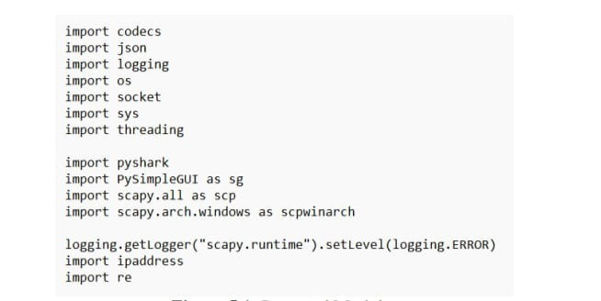
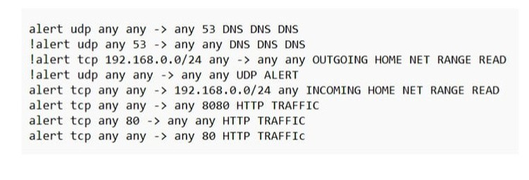
CODE INCLUDIND MODULES ,RULES etc
IMPORTED MODULES
RULES

Slide 27
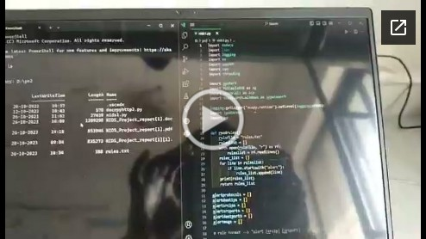
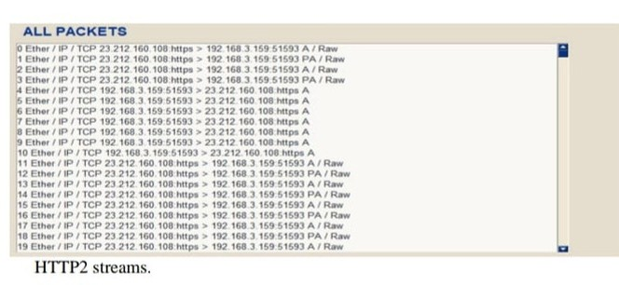
DEMO VIDEO LINK.....
https://drive.google.com/file/d/1CTa_WZDCbxzLnilfZ3Zx
8uPK_Ux0Ppv0/view?usp=sharing
ALL PACKETS

Slide 28
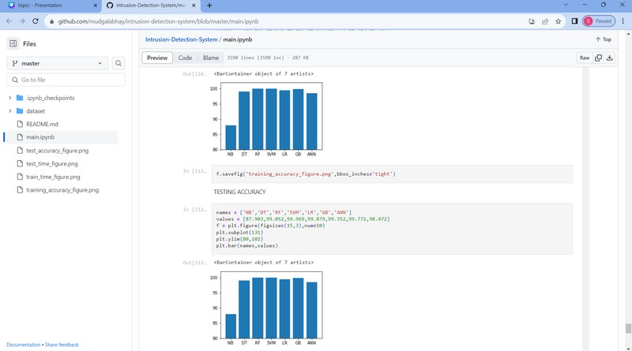
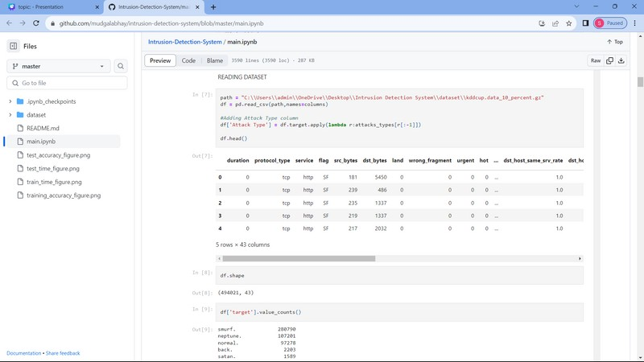
SNAPSHOT OF CODE:
ACCURACY READING...
READING DATASET.....

Slide 29
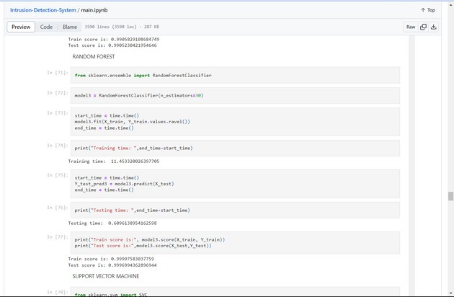
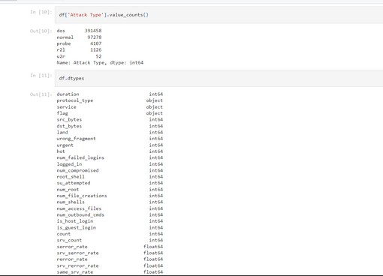
EXAMPLE:SOME ATTACK TYPE
EXAMPLE: ALGORITHM UESD

Slide 30
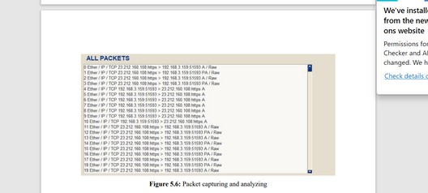
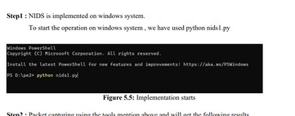
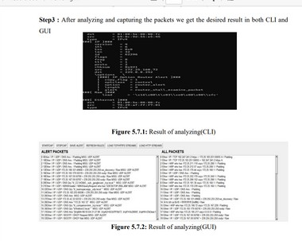
TESTING:
STEP 2:
STEP:1
STEP 3:

Slide 31
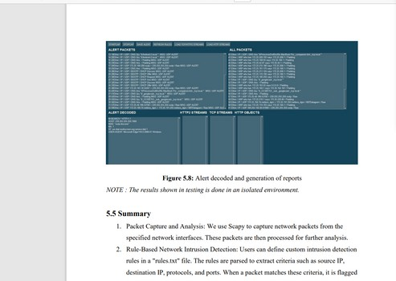
RESULTING OUTCOME:
Resulting outcome helps us to detect the any vulnerabilities or malicious activity in the system by comparing with various defined attacks and using algorithms and sending alerting message to the user.

Slide 32
Conclusion:
In conclusion, this project has provided a comprehensive overview of Network Intrusion Detection Systems (NIDS) and their evolution in the field of network security. The project's objectives included analyzing
various NIDS methodologies, understanding research trends, and highlighting the critical role of quantitative measures in assessing the effectiveness of intrusion detection methods. The report has effectively
summarized the landscape of NIDS, encompassing research spanning from 2005 to 2020. By employing
citations as a quantitative metric, it has measured the popularity and impact of different intrusion detection methods. The project has presented valuable insights into the field, showcasing trends and patterns in
intrusion detection research. Notably, the observation that conference publications tend to receive higher citation counts than journal articles underlines the significance of academic conferences in disseminating research findings in this domain. This report serves as a valuable resource for cybersecurity professionals, researchers, and practitioners. It offers a consolidated view of the NIDS landscape, its historical evolution, and 39 the prominence of various methodologies. By presenting the strengths and weaknesses of different approaches, it equips professionals with the knowledge needed to make informed decisions in the ever-
evolving field of network security. However, it's important to acknowledge the limitations and constraints associated with the proposed system for testing NIDS effectiveness. These limitations include issues related
to operating system compatibility, testing scope, resource requirements, ethical considerations, and the need for ongoing updates and maintenance. Additionally, the enhancements discussed, such as expanding the ruleset and automation using AI, highlight the continuous need for innovation and adaptation in the
cybersecurity field.

Slide 33
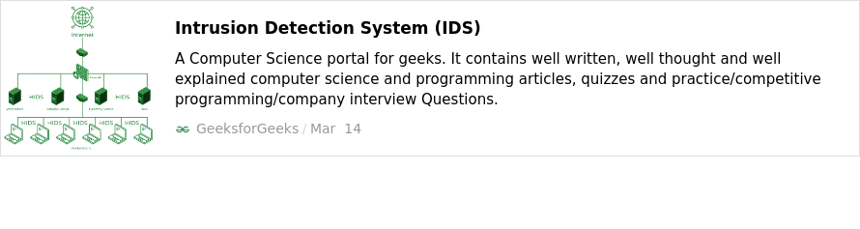
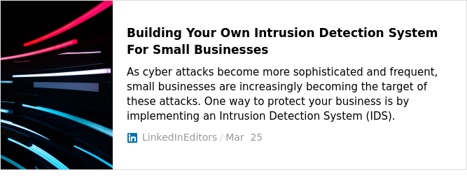
REFRENCE:
https://www.sciencedirect.com/topics/computer-science/network- based-intrusion-detection-system

Slide 34


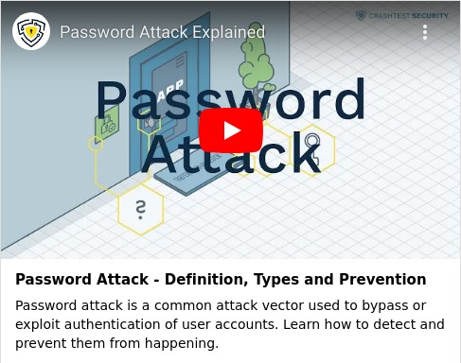
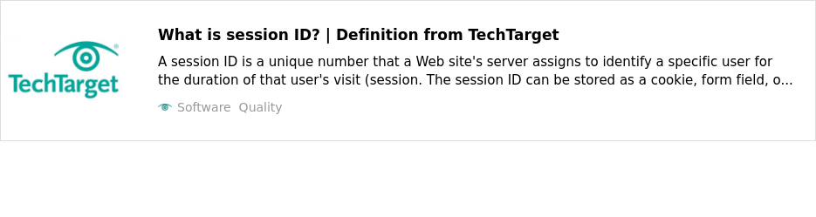
REFRENCE:

Slide 35







THANK YOU

